Slide 1

Database for ‘Intervue’ DBMS Final Project

Slide 2

What is Intervue?
Intervue is an innovative Interview-as-a-Service platform that bridges the gap between companies and candidates by providing professional interview services. It acts as a mediator, ensuring that client companies receive high-quality candidate assessments through structured and efficient processes.

Slide 3

The purpose
The primary purpose of this project is to create a robust and centralized database system to enhance the efficiency and effectiveness of the Intervue platform. The database will serve as the backbone of the platform, enabling seamless data management, efficient operations, and insightful analytics for all stakeholders.

Slide 4

Business requirements
Stakeholders: Client companies, Interviewers, Candidates
Key Database Functions:
-Manage client, candidate, and interviewer information
-Track job postings and applications
-Record detailed skills feedback for candidate evaluation

Slide 5

Objectives
The primary goal is to streamline the candidate evaluation process, ensuring an efficient and structured pathway from application to final selection by client companies. This involves:
Application Processing: Seamlessly manage candidate applications, ensuring relevant details are captured and made accessible for assessment.
Interview Facilitation: Organize and schedule interviews between candidates and professional interviewers, matching expertise with job requirements.
Feedback Mechanism: Empower interviewers to provide detailed evaluations of candidate performance using a structured feedback rubric that highlights strengths, weaknesses, and skill proficiency.
Client Reporting: Compile interviewer feedback into comprehensive reports to assist client companies in making informed hiring decisions, reducing the time and effort spent on initial screening.

Slide 6

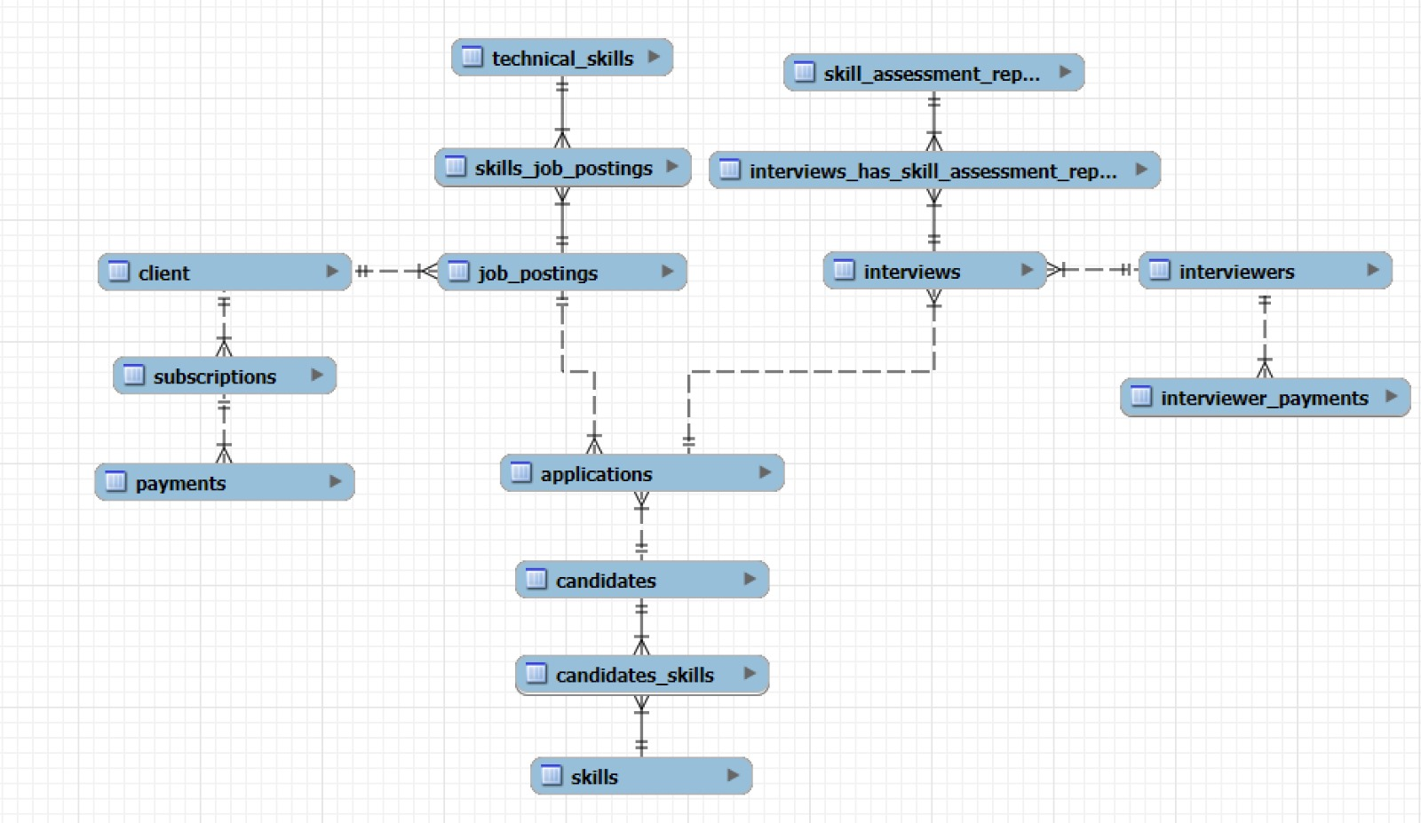
The Entity-Relationship Diagram

Slide 7

Entities and Attributes
Some of the entities and their attributes are:
Clients
client_id (INT)
name (VARCHAR)
email (VARCHAR)
phone_number (VARCHAR)
address (VARCHAR)
region (VARCHAR)
city (VARCHAR)
zipcode (VARCHAR)
Interviewers
interviewer_id (INT)
first_name (VARCHAR)
last_name (VARCHAR)
email (VARCHAR)
phone_number (VARCHAR)
specialization (VARCHAR)
rating (INT)
hourly_rate (DECIMAL)
qualification (VARCHAR)
Candidates
candidate_id (INT)
email (VARCHAR)
first_name (VARCHAR)
last_name (VARCHAR)
phone_number (VARCHAR)
education (VARCHAR)
profile_status (VARCHAR)
address (VARCHAR)
region (VARCHAR)
city (VARCHAR)
zipcode (VARCHAR)
skills_skill_code (INT)

Slide 8
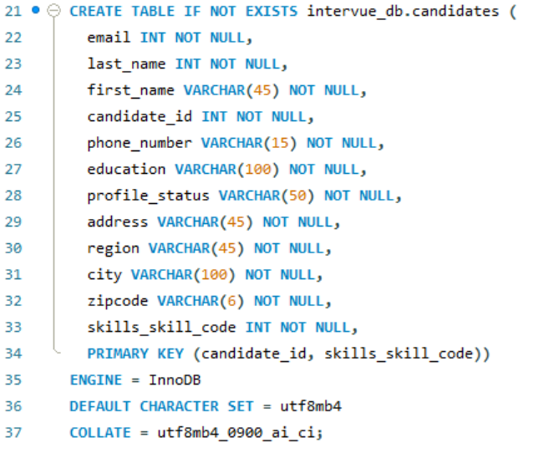
Table creation

Slide 9
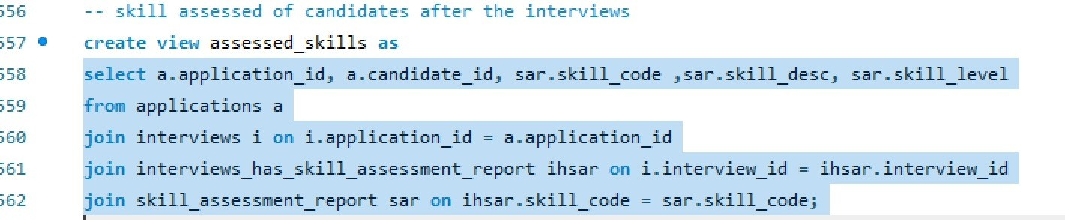
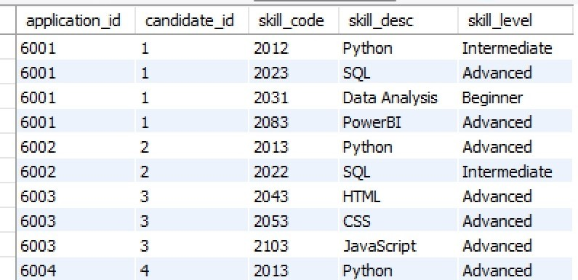
The Input and output

Slide 10


Expected Outcomes
Centralized data management for clients, candidates, and interviewers.
Seamless tracking of job postings, applications, and interview outcomes.
Streamlined candidate matching process based on skills and qualifications.
Standardized feedback mechanisms and detailed performance reports for client companies.
Enhanced operational efficiency

Slide 11

Conclusion
In conclusion, the proposed database system will centralize data, streamline processes, and enhance decision-making for Intervue. By improving efficiency, accuracy, and scalability, it will provide a seamless experience for clients, candidates, and interviewers, ensuring long-term success and growth for the platform.

